Slide 1
Writing Papers
Lirong Xia
Graduate Skills Seminar, 2019
Ack: Prof. Fran Berman

Slide 2
Not so hard
Do good work (most important)
Write the paper (this talk)
It is your work, not your advisors’
Not really about language, more about the structure and logic
Overcome procrastination
Improve over iterations
Next paper

Slide 3
Getting ahead entails good ideas communicated well
Success in research = good results + good communication about your results
Success in business = good ideas + good follow-through + good communication about your work
Good communication =
“Elevator pitch” for professional conversations
Good presentations
Good writing
Conferences, journals, proposals, reports, white papers, etc.

Slide 4
Writing as a Communications Vehicle
Writing exists in a cultural context. Know your professional culture and how it communicates. Your writing should be in the same style as others in your group and should be optimized for your reader.
Why are you doing this? (What purpose does your paper serve?)
Raising awareness for your work?
Building your credibility as an expert?
Documenting work for the scholarly record?
Who is your audience?
Specialists? Stakeholders? The public?
What is your story?
What is important about it?
What is noteworthy/memorable about your approach?

Slide 5
Writing as a Creative Process
Writing advances your technical understanding. Many details and the overall story are refined when you write things up. (Especially true for your thesis and grant proposals …)
Writing can help organize the way you think about your results
You may have created the results in an exploratory way but usually write them up as part of a well-structured plan
Writing can help put your work in context
You’ll discover a lot about your work by setting it in context with others
Writing may lead you to additional work
Do you need to do more in order to present strong results?

Slide 6
Writing is a skill you keep getting better at
The first draft of anything is sh*t---Ernest Hemingway
If you don’t get accepted … DON’T GIVE UP
my first independent work was rejected for 7 times
“Bounce”/improve the work!
Get over it, look at the reviews and improve the piece
Get more results if needed
Send it somewhere else (or for another round)
Not getting accepted doesn’t necessarily mean that the work is bad (original PageRank paper rejected from SIGIR in 1998…)

Slide 7
Heilmeier’s Catechism (from Wikipedia)
George Heilmeier was former Director of DARPA (Defense Advanced Research Projects Agency , former CTO of Texas Instruments, former President of Bellcore, and former CEO of SAIC. Heilmeier’s Catechnism is a set of questions credited to Heilmeier that anyone proposing a research project or product development effort should be able to answer:
What are you trying to do? Articulate your objectives using absolutely no jargon.
How is it done today, and what are the limits of current practice?
What's new in your approach and why do you think it will be successful?
Who cares?
If you're successful, what difference will it make? (value proposition)
What are the risks and the payoffs?
How much will it cost?
How long will it take?
What are the midterm and final "exams" to check for success? (milestones, metrics of success)

Slide 8
Targeted Writing
Conference Papers
Journal Papers

Slide 9
What should you write about?
Focus on a problem that is compelling to your audience and that you can articulate well.
Make sure that your solution is credible and well-evidenced
You should have a sense of the “metric of success” for solutions – what does it mean to solve the problem?
The problem statement should be persuasive (why should your audience care?). The solution “story” should be solid.
Where do you find problems?
Papers in the area
Your advisor and other experts
Extension of an approach to a richer setting or more applications
Extension of an approach by changing the context / parameters
Your own curiosity

Slide 10
Writing Conference Papers
Audience: Specialists in your general area (e.g. programming languages, data mining, HPC)
In peer-reviewed conferences, first you need to get accepted by the Review Committee
Review committees:
Have a lot of papers to read in a short period of time -- You need to “sell them” early
Make your results compelling and clear on the first page
Make your paper easy to skim (graphics, organization, line spacing, font)
Are looking for new results that advance the state of the art
Make the innovative aspects of your paper clear up front
Are often looking for “hot” topics
Can you relate your results to a community / national priority or new area?

Slide 11
Writing Conference Papers – Structure
The structure of your paper is dependent on conference and area. Read “best papers” from your target conference as a model. (Best papers in many conferences at http://jeffhuang.com/best_paper_awards.html)
Generic format
Introduction
(Related work)
Approach
(Related work)
Results
(Future Work)
Conclusion
References
Increasing number of conferences may expect you to cite your data.
Get in the habit of doing it.

Slide 12
Writing Conference Papers – More Detail 1
Abstract
1-2 paragraphs summarizing the paper and results. Should be well-written and broadly understandable.
Introduction
~1 page – should tell reviewer everything they need to know about what you are doing and why it is important.
This is the time to catch the reader and make a positive first impression. Spend the extra time to make this compelling, exciting and interesting.
Related work
Generously include work that’s relevant, especially from likely reviewers
Diplomatically describe why their work doesn’t solve your problem (“Berman’s work focused on networks in which communication costs are zero. Our work focuses on networks in which communications costs are positive and vary dynamically”)
Related work is sometimes positioned later in the paper.

Slide 13
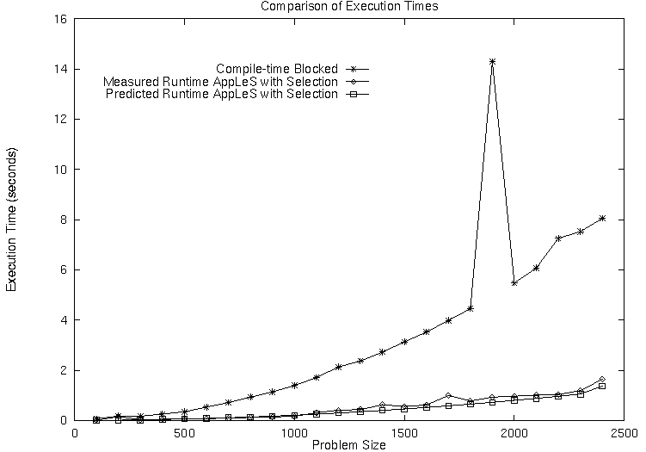
Writing Conference Papers – More Detail 2
Approach
Clearly describe the problem you’re solving and your approach to solve it: methods, experiments, theorems, etc.
Provide enough detail to make your approach credible and reproducible
Results
Make the work visually accessible and interesting. Well-described graphs and visuals (tables, etc.) can be great additions
Provide insight into the trends in your data and what they imply with respect to the problem and the area.
Run-time AppLeS Partitioning
Compile-time Blocked Partitioning

Slide 14
Writing Conference Papers – More Detail 3
(Future Work)
What needs to be done next?
This can help increase the interest and motivation for the work you’ve already done.
Sometimes not included.
Conclusion
.5 page? Should be as self-contained as possible, compelling, and less than a page: What did you do, how did you do it, what are the results, why should we care.
Acknowledgements
People who helped who are not authors. Be generous.
References
Be relevant and generous. Use the standardized reference formats for your community.

Slide 15
Writing Journal Papers
Journal papers are the archival record of your work. This is the place for comprehensive detail and thorough description of what you have done.
Audience: Specialists in your specific area (e.g. exascale programming environments) and in the general area (e.g. HPC)
Journal papers
Should include enough details so that results can be reproduced when possible
Should provide detailed methodology and charts and graphs of results
Should include data citations so paper is “self-contained”
Should stand up if read “with a fine toothed comb”

Slide 16
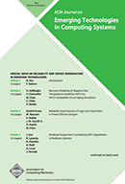
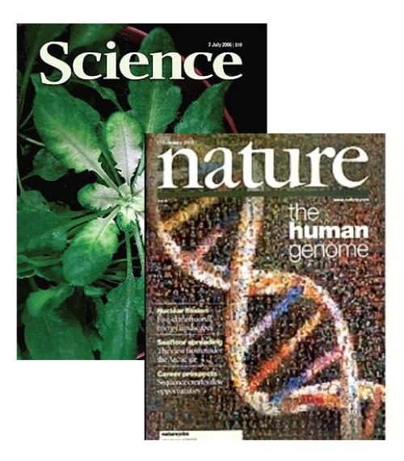

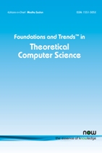
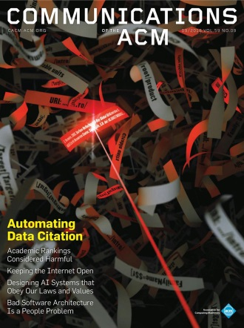
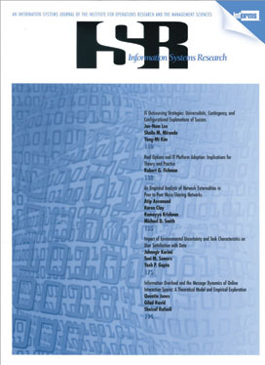
Writing Journal Papers – Organization
Organization of the paper is dependent on journal and area. Read other papers from the journal as a guide.
Generic format
Introduction
Related work
Approach
Results
Future Work
Conclusion
References

Slide 17
Writing Journal Papers – More Detail 1
Use the same basic structure for journal and conference papers. All guidelines about clear and compelling writing in conference papers apply.
In a Journal paper, you have more room and are expected to go into greater detail.
Reviewers expect to spend more time on these and provide detailed feedback to you.
Write the paper assuming that every detail will be gone through with a fine-toothed comb.
Differences between Journal and Conference Papers
Introduction -- you have a bit more room than a page. In a 20 page paper, you can spend 2+ pages motivating the problem and your solution.
Related work – You can go more into detail about what other people have done and where your work fits in. Remember that you need to both show that your work is different and not put down other’s research

Slide 18
Writing Journal Papers – More Detail 2
Differences between Journal and Conference Papers:
Approach – Provide a detailed methodology that could be reproduced. Provide enough detail about parameters, hardware, software, data, versions so that someone else could reproduce your results with the same setup if possible.
Results – Explain your results and their significance thoroughly. Why did the graph spike? Under what circumstances was one method better than another?
Future Work – Include future approaches and problems that this work could support. Spend < 1 page on this.
Conclusion – Make this self-contained and clear. Spend < 1 page on this.
References – Can include even more refs. Be generous and thorough.

Slide 19
Journal papers can be dense but still need to be understandable …
https://datascience.codata.org/articles/10.5334/dsj-2018-019/
https://cacm.acm.org/magazines/2018/4/226372-realizing-the-potential-of-data-science/fulltext

Slide 20
Optimizing your chances of success (conference and journal papers) 1
Make the paper easy / fun to read
Use graphics to compellingly convey the message
Use font / spacing / italics and bolding / section organization / color to make the paper fun to read
Don’t jam every possible space and use super-small font
Do multiple drafts until you get it to a level that will promote your success
Present your work professionally
Use “we” vs. “I”, even if there is only one of you
Don’t oversell nor undersell. Study how other authors subtly promote the importance of their work without sounding arrogant (the “humblebrag”!).
Look at “Best Paper” recipients in your conference or highly ranked journal articles for good examples of writing and results
Do not plagiarize – if you want to refer to something explicitly or implicitly, cite the work and give credit to the authors.

Slide 21
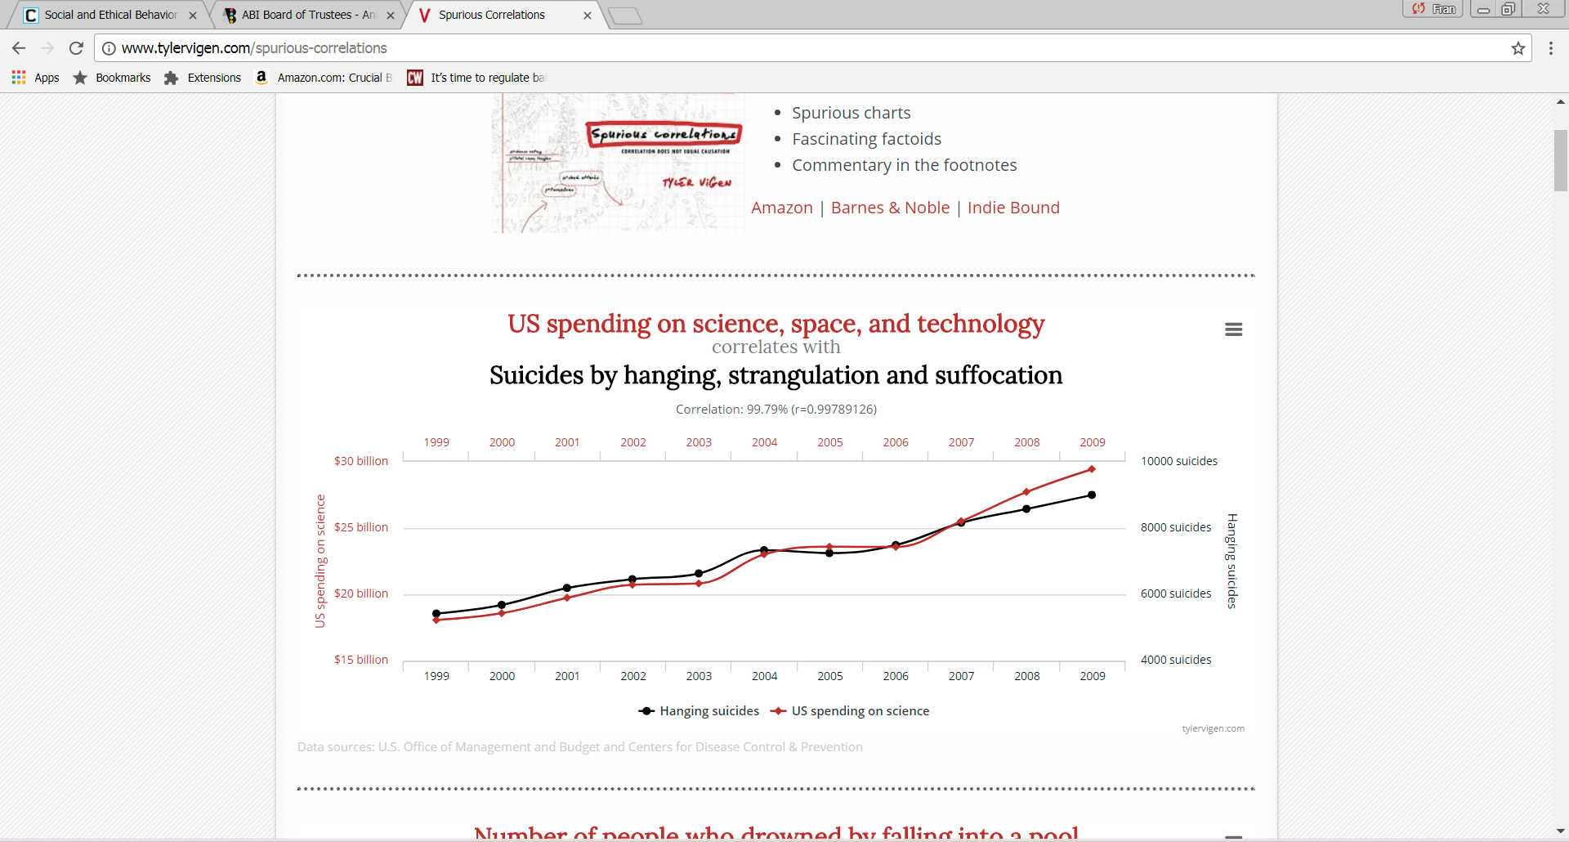
Optimizing your chances of success 2
Be careful about correlation vs. causality:
Many phenomena happen
together without a causal
relationship
Strive to make your work reproducible:
Include enough detail about methods, hardware, software, parameters, etc. so that someone could conceivably reproduce your results.
Share code and data when possible. Issues about what to share and what is competitive advantage still under discussion https://web.stanford.edu/~vcs/papers/RoundtableDeclaration2010.pdf
Use “Red-team” reviewers:
Pick knowledgeable and trustworthy colleagues to read and critique your paper.
Revise the paper based on their reactions and their comments on strengths and weaknesses.
From http://www.tylervigen.com/spurious-correlations

Slide 22
Optimizing your chances of success 3
Cite your data:
Provide a publicly accessible place for your data – ingesting your data in a public or institutional repository is best if the Journal does not provide repository services.
Create a citation for your data.
Use community practice / standards to refer to your data. (https://www.rd-alliance.org/group/data-citation-wg/outcomes/data-citation-recommendation.html provides a community approach that includes dynamically changing data sets). Include relevant metadata.
Be a nice citizen
Pay attention to page length. If there are page limits (e.g. in conferences), don’t just make things smaller to fit in.
Be generous with related work – include relevant potential reviewers
Don’t dis others

Slide 23
Op-eds: A written elevator pitch …
An Op-ed is a short written piece that expresses your opinion.
Audience: General public / non-specialists
Publication venue: Newspaper, magazine, etc.
Purpose: Persuasively get your point of view across
Op-eds (and blogs) can have tremendous influence on community and stakeholders
Can establish you as an expert
Can get your point of view into the national discourse
Can be useful to your company, project or community
Writing Op-eds can help train you as a persuasive communicator

Slide 24


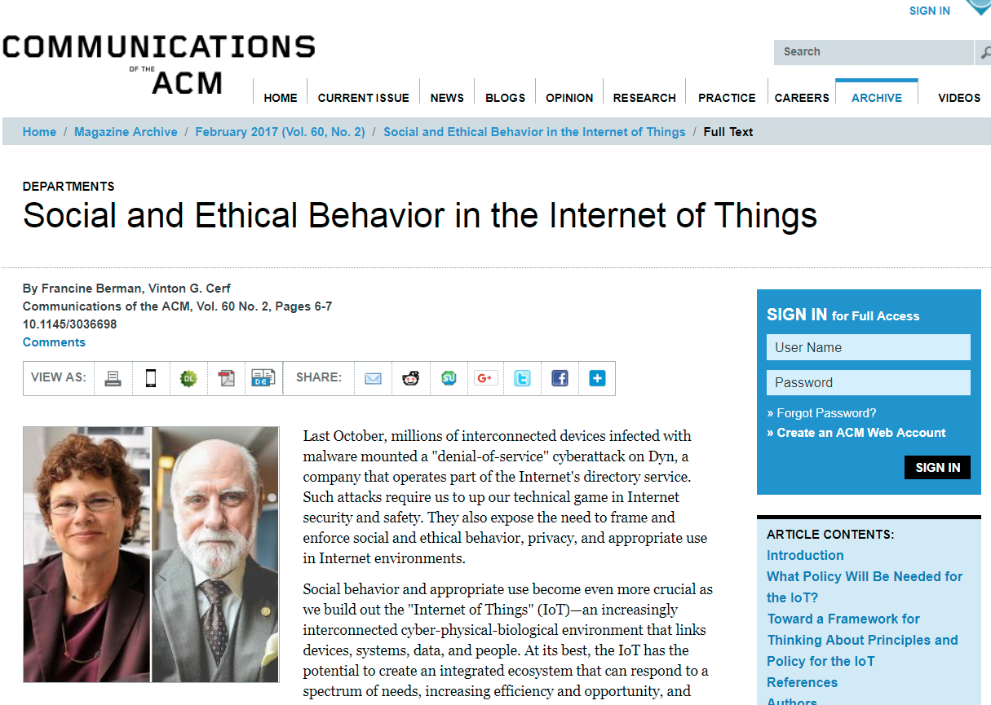
Op-Eds give your opinions a voice

Slide 25
Op-Eds provide evidenced opinions
Lede Options
Current news
Dramatic or personal anecdote
Reference to popular culture or twist on conventional wisdom
Anniversary of an event
Major new study
Not all Op-Eds are like this, but many good Op-Eds have this structure:
Lede – Lead-in around a news hook or personal experience
Thesis – your position (explicit or implied)
Argument – should be based on evidence (stats, news, reports, expert quotes, scholarship, history, experience). Arguments often presented as a series of points.
Criticism pre-emption – take the lead in acknowledging the flaws in your argument and address potential counter-arguments
Conclusion – circle back to lede?

Slide 26
Op-Ed Tips (also great tips for any “elevator pitch” type of communication)
Write in a way that generic smart people can relate to; don’t assume they know your discipline.
Don’t use buzzwords or talk “inside baseball” without explaining things.
Make it short and compelling -- Pay attention to publication word count – op-eds are often less than 1000 words
The final version may be reviewed and/or edited – what you send in may not be the final draft
Do your homework – everyone will read this
Be prepared for feedback – comments, tweets, etc.

Slide 27
Keep at it
Writing is a useful skill no matter what job you have
Good writing takes effort. Better writing takes practice. You will keep improving your writing throughout your career.
If you don’t get accepted … Don’t give up
“Bounce”/improve the work!
Get over it, look at the reviews and improve the piece
Get more results if needed
Ask for help from your network
Send it somewhere else (or for another round)
Good reference for all of these concepts with additional details at http://www.cs.ucr.edu/~eamonn/Keogh_SIGKDD09_tutorial.pdf

